Slide 1
Intro2CS
67101-2
Lecture 1.0
Dr Arie Schlesinger
Spring 2020,
CS.HUJI

Slide 2
The Course Staff
Lecturer
Dr. Arie Schlesinger
Tzars:
Yaacov Weiss
Yitzchak Vaknin
Teaching Assistants:
Ziv Ben Aharon
Adi Cogan
Guy Amir
+ Supervised Lab teachers
+ Computer Lab support
slides 2-22 from materials of the course “Introduction to Computer Science-67101”, 2019-20 at Huji
by Prof. Jeff Rosenshein and Prof.Aviv Zohar

Slide 3
Tzars
Yaacov Weiss – Autotest Tsar
Write automated tests for exercises, autotest appeals, etc.
Yitzchak Vaknin– Communications Tsar
Answer course emails, etc.

Slide 4
Computer Science
Computers and programming are tools,
Science however is not about tools, although it studies how to use them.
It is about what to do with what we find out.
CS is not about computers, nor programming,
It is about solving problems.
It is the science of algorithms
How to solve a problem, by Richard Feynman (Nobel in physics, 1965) ?
Define the problem
Think hard
Write the results

Slide 5
Problem solutions
Problem solutions have a kind of general sequence format (or better have one):
-1st do this
-2nd do that
…
-n^{th} that’s it
such a sequence is called an algorithm: a set of rules to be followed in a problem-solving process.
(here in an almost natural language )

Slide 6
Translations lane
Breakfast
Read the problem
Create an Algorithm
Program it in a ‘high level’ language
Machine part (metalic smart dumm kopf)
Translate prev program to a low-level language (assembly/byte code)
Translate prev program to machine language
Run it

Slide 7
This course
During this course:
we’ll learn how to write programs that realize algorithms that solve problems…
study some important subjects and algorithms

Slide 8

Computational problems

Slide 9
Problems Types Examples given a positive integer (n)
Decision problem(primality):
determine if n is prime.
Function problem (factoring) :
find a prime factor of n .
Search problem:
find all prime factors of n.
Counting problem:
Count the number of prime factors of n.
Optimization problem : find the "best possible" solution among all solutions of a search problem.

Slide 10
About Python
Open source general-purpose language.
• Great interactive environment
• Developed by Guido van Rossum in the early 1990s
• Named after Monty Python
• Available on lab computers
• “Official” materials at http://www.python.org
• Several softwares are available,
• There are two Python flavours: 2.7.x / 3.8.x
We'll learn flavor 3.8.x, So look for materials on Python 3
סימני היקר:
Python2: print…,
Python3: print(…)
There are differences between python 2.x and python 3.x

Slide 11
software
There are different implementations of the
interpreter and Python IDE’s, like:
pycharm, IronPython, IDLE, winpython
ActivePython, Wing, Jython, pydev, etc.
(each has a complete programming environment that provides working support.)
IDLE - simple and practical
WinPython (a bundle that has an interpreter + a lot of packages + and an IDE called Spyder)
Pycharm - supports more professional work, this IDE is set up on the lab computers
…

Slide 12
Software downloads, docs
• Available for download from http://www.python.org
Also at https://www.anaconda.com/
• Documentation: http://www.python.org/doc/
• Free books (mostly): http://pythonbooks.revolunet.com/
Think python - excellent:
https://media.readthedocs.org/pdf/howtothink/latest/howtothink.pdf
http://www.openbookproject.net/books/bpp4awd/ (online)
More:
A Byte of Python
Learn Python The Hard Way
Building skills in python
Google course (python 2): https://developers.google.com/edu/python/
© Dr. Arie Schlesinger, 2017

Slide 13
Where to find help when programming
Try things out. You won’t break anything
Google is your friend
Tutorials and docs on python website
Books
Example: “Think Python, How to Think Like a Computer Scientist”. Online (for python 3) here: http://faculty.stedwards.edu/mikek/python/thinkpython.pdf

Slide 14
Programs
Consider them as a kind of Virtual Machines, that manipulate data to solve problems.

Slide 15

Look
A general look at a program as a text, reveals: - the data : literals, or names of data, - the machinery

Slide 16
data and parts
print(2 + 3)
...
x = 5
if x % 2 == 0 :
print(‘Even ’)
else:
print(‘Odd’)
….
2, 3 , 5, 0, Even, Odd are data: literals (numbers, strings)
x is a name of the value 5 ,
we see ‘the machine parts’ in black

Slide 17
Python ‘warehouse’
The machinery :
Is used to manipulate data
- Is assembled from ready-made parts taken from a ‘Python warehouse’
Most languages have similar parts for similar operations.

Slide 18
Python interpreter (מפרש)
Python is an interpreted language. Python
programs are executed by an interpreter (מפרש).
An interpreter is a program that reads and executes your (python) code directly.
Instructions are read, executed/evaluated, and the results are returned.
A compiler first converts the source code into machine code, which later can be run by the operating system as an executable program.

Slide 19
REPL:Read Eval Print Loop
So, when you type something at the prompt, then press enter: the interpreter reads, evaluates, prints the result.
Then the prompt is ready again for another dialog

Slide 20
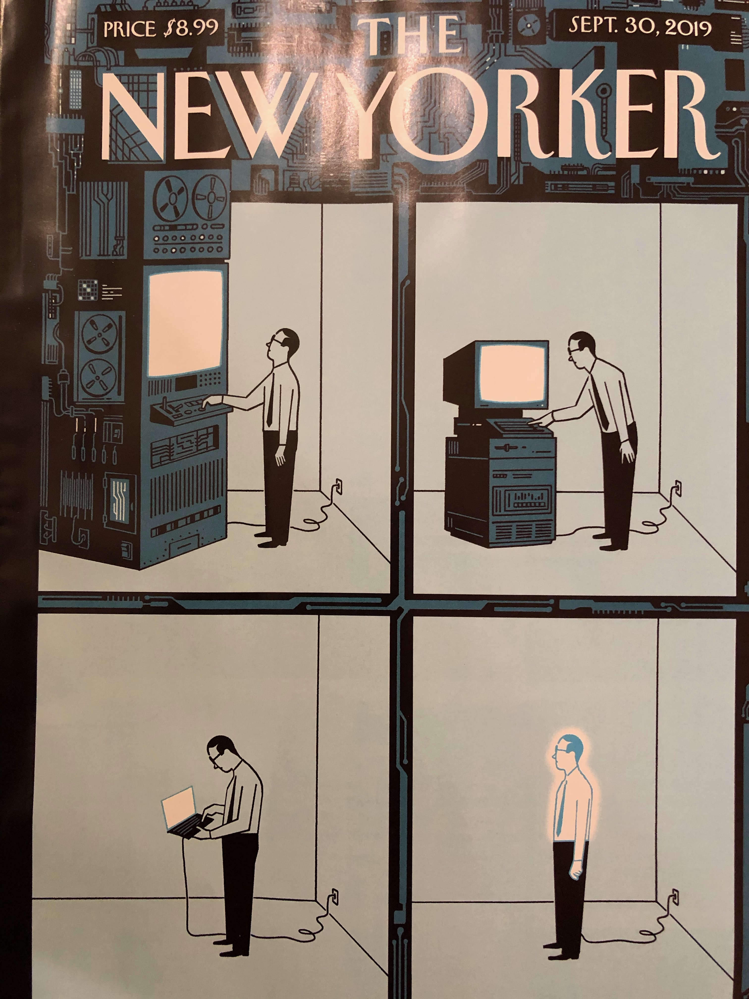
Computers sizes in time

Slide 21
What is this course about?
This course aims to give you:
basic programming skills
Python 3
foundations of computer science theory
Algorithms and their formal analysis
a taste of things that you can do with programming
Image processing, connecting on the internet, GUIs, artificial intelligence, etc.
Programming basics (python)
Basic Algorithms
More advanced topics

Slide 22
Course Mission Statement
“To give the student the tools to develop correct, efficient, well-structured, and stylish programs, and to build a foundation for further studies in Computer Science.”
-An Introduction to Computer Science with Java Kamin, Mickunas, and Reingold

Slide 23
Course tentative schedule 2019-2020
1 | Introduction, functions, variables, types, expressions
2 | Conditionals, strings, parameters, loops
3 | More loops and lists; Set, dictionary, comprehension, slicing
4 | Aliasing, scope, mutability, tuples; Debugging
5 | Refactoring, program construction, clean code testing with pytest; Numeric algorithms, runtime analysis
6 | Simple search and sorting; more runtime analysis
7 | Recursion; Backtracking
8 | Object Oriented Programming [OOP]
9 | More OOP; Linked data structures: Lists
10 | Exceptions
11 | Linked data structures: Trees, Graphs; 2nd-order functions
12 | More 2nd-order functions, closure and decorators; Event-driven prog. / GUI; the Python type system
13 | Generators and iterators, networking, cloud deployment
14 | Turing Machines, Halting Problem, and Gödel

Slide 24
Where to find all needed information
www.cs.huji.ac.il/~intro2cs2
Notice the “2" at the end of the URL
(points to Moodle webpage of the course)
exercises, lecture slides, office hours, forums, course email, etc.

Slide 25
Make sure you read the course policy on the website!
This course has many students, things will run smoothly only with your help
Know where to direct your questions/requests:
Personal issues – email intro2cs2@cs.huji.ac.il
Questions about exercises – forums
Exercise appeals – forums
For questions regarding the material: We also have office hours (Teachers and TAs) & lab support.
The only way to get an official answer to a targil question is by using that targil's online forum!
All your direct email communication (e.g., miluim and other personal requests) is with intro2cs2@cs.huji.ac.il - we will figure out who handles your email

Slide 26
Open an account
If you do not yet have an account:
Go to https://registrar.cs.huji.ac.il/account
Enter your ID number and open an account
Pick username and password carefully!
If something does not work: contact the System group: system@cs.huji.ac.il

Slide 27
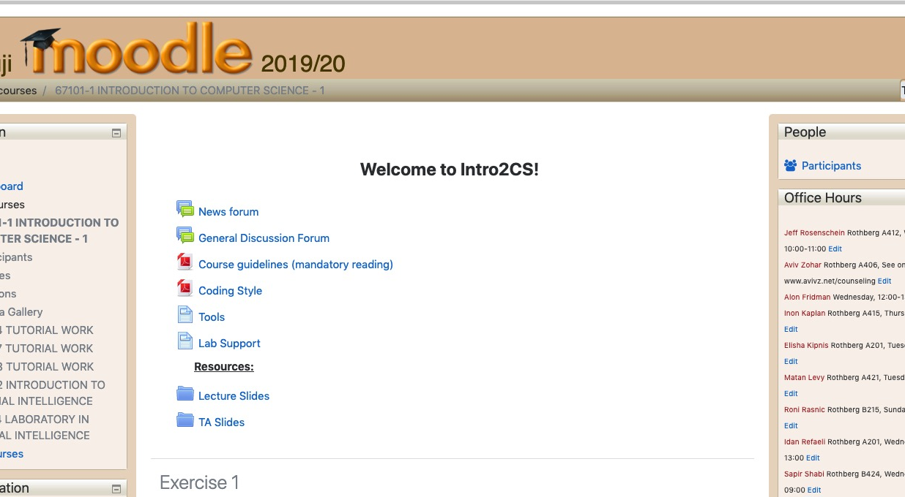
Intro2cs2 moodle page

Slide 28
Online teaching
Recorded Lectures and Tirgulim materials will be provided.
Expect an exercise to work on every week. Programming takes time especially if you have little or no prior experience.
An exercise is already online!
“After the Corona”, teaching will proceed as posted in the HUJI Shnaton

Slide 29
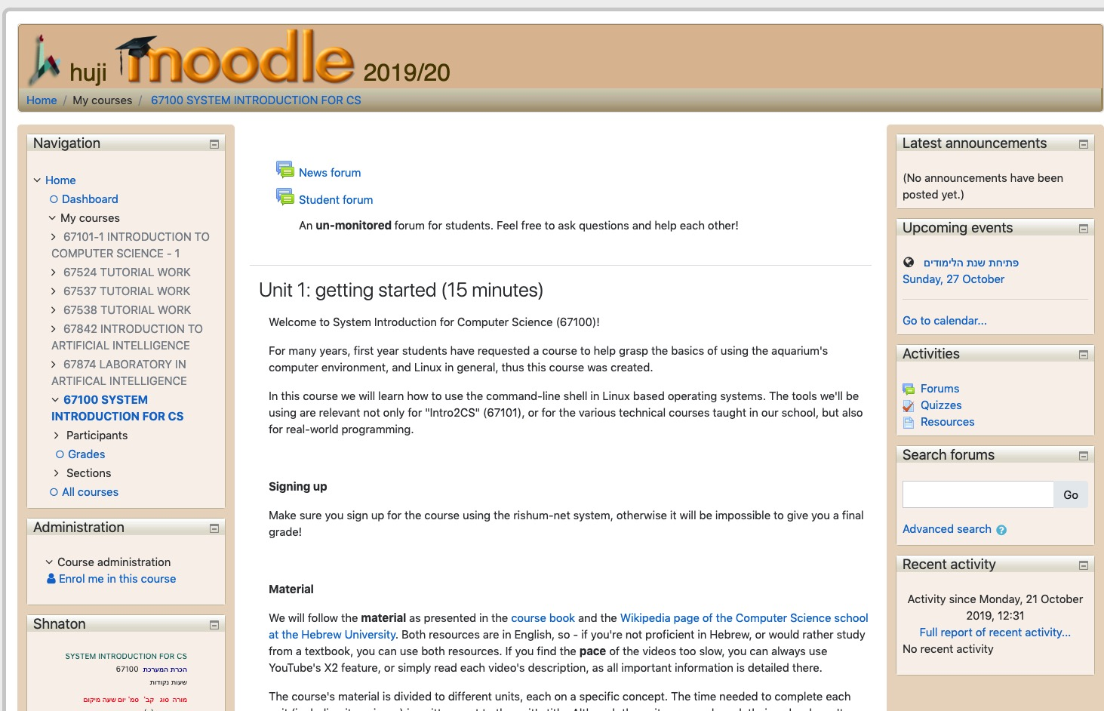
Learning How to Use the System
67100 – SYSTEM INTRODUCTION FOR CS

Slide 30
What to expect
A programming exercise (targil) approximately every week; out of n targilim, we will use n-1 highest (final targil counts as 2 targilim)
(50% of final grade)
A written exam at the end of the course
(50% of final grade)
Must have passing grade (at least 60) in both to pass course
Targilim grades tend to be [much] higher than written exam grades, don't be misled

Slide 31
Info about supervised labs, quizzes, and magen
Supervised Labs, 2 hours per week
Attendance is strongly encouraged (see next slide), but not mandatory
Small groups of students program with lab support feedback, getting more comfortable with programming and thinking algorithmically
Quiz most weeks, to be completed in Moodle, during supervised lab

Slide 32
You Learn By Doing Targilim
Learning through Doing
למידה מתוך לעשיה

Slide 33
On Problem Sets (and Exams)
NO COPYING!
Every student must solve the targil on his own.
על כל סטודנט לפתור את התרגיל בעצמו.

Slide 34

You are not allowed to be told what to write in a program, or to read someone else’s code.

Slide 35
What IS Allowed?
Discussion is allowed, even encouraged, but without looking at code!
You are required to list students you discussed an ex with (in comment at top of main file of each exercise)
How do you know if you are doing something wrong? If you are looking at someone else’s code or someone is looking at yours, this is definitely not allowed
If someone copies from you, both of you are responsible!

Slide 36
IF SOMEONE COPIES FROM YOU, BOTH OF YOU ARE RESPONSIBLE!

Slide 37
Jupyter presentations
During the course we’ll use presentations written with a tool called [The Jupyter Notebook](http://jupyter.org/) (מחברת יופיטר)
It runs code interactively (interpreter!),encourages focusing on each detail along the lecture, by a lot of related practice code.
- The sources will be online
[website](http://www.cs.huji.ac.il/~intro2cs2)
- you can run it yourselves in several ways:
- packaged with WinPython (click the jupyter icon in the
winpython directory)
- On the linux machines run `jupyter notebook`
- Can be easily [installed](http://jupyter.org/install.html) in other distributions of linux.
- Run them on [Google cloud](https://colab.research.google.com)
or with anaconda distribution on windows/mac/…

